Slide 1

Accelerating the Adoption of Electric Vehicles
Technology Driven Performance Improvements and Cost Reduction
May 2024

Slide 2

Disclosures
This presentation contains forward-looking statements within the meaning of Canadian securities laws. These statements relate to future events or future performance and reflect management’s expectations regarding the Company’s growth, results of operations, performance and business prospects and opportunities. Such forward-looking statements reflect management’s current beliefs and are based on information currently available to management. In some cases, forward-looking statements can be identified by terminology such as “may”, “will”, “should”, “expect”, “plan”, “anticipate”, “believe”, “estimate”, “predict”, “potential”, “continue”, “target” or the negative of these terms or other comparable terminology.
Forward-looking statements are necessarily based on estimates and assumptions made by management in light of management’s experience and perception of historical trends, current conditions and expected future developments, as well as factors management believe are appropriate. Forward-looking statements may include but are not limited to statements respecting volatility of stock price and market conditions, technology risks and risks associated with the commercialization of Company's technology, regulatory risks; the Company's reliance on key personnel; the Company's limited operating; market uncertainties, and the protection of patents and intellectual property.
These forward-looking statements are based on the beliefs of the management of Exro and on assumptions which such management believes to be reasonable, based on information available at the time such statements were made. However, there can be no assurance that forward-looking statements will prove to be accurate. Such assumptions and factors include, among other things: demand for the technology of the Company; the Company's ability to maintain existing partners and attract new partners; the impact of competition; the Company's ability to obtain and maintain existing financing on acceptable terms; the Company's ability to retain skilled management and staff; currency, exchange and interest rates; the availability of financing opportunities, risks associated with economic conditions, dependence on management; conflicts of interest and market competition; the ability to commercialize the Company’s technology; and operating in an environment subject to regulation.
The preceding list is not exhaustive of all possible factors. Although the Company believes that the assumptions underlying these statements are reasonable, they may prove to be incorrect, and the Company cannot assure that actual results will be consistent with these forward-looking statements. Given these risks, uncertainties and assumptions, any investors or users of this document should not place undue reliance on these forward-looking statements. Whether actual results, performance or achievements will conform to the Company’s expectations and predictions is subject to a number of known and unknown risks, uncertainties, assumptions and other factors
Please refer to the Company's annual information form and other public disclosure documents filed with the Canadian securities regulators under its profile at www.sedar.com for additional disclosure respecting the risks affecting the Company and its business.
Readers should not place undue reliance on the Company’s forward-looking statements, as the Company’s actual results, performance or achievements may differ materially from any future results, performance or achievements expressed or implied by such forward-looking statements if known or unknown risks, uncertainties or other factors affect the Company’s business, or if the Company’s estimates or assumptions prove inaccurate. The Company does not undertake to update any forward-looking information, except as, and to the extent required by applicable securities laws.

Slide 3
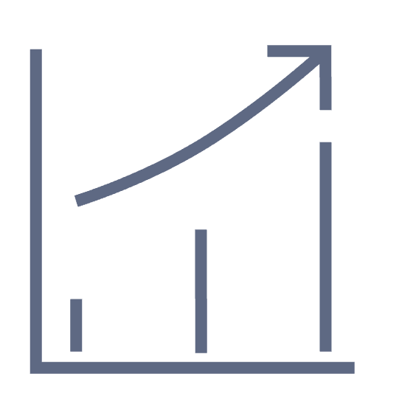



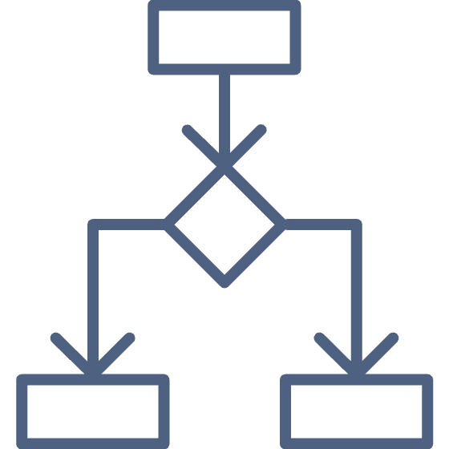

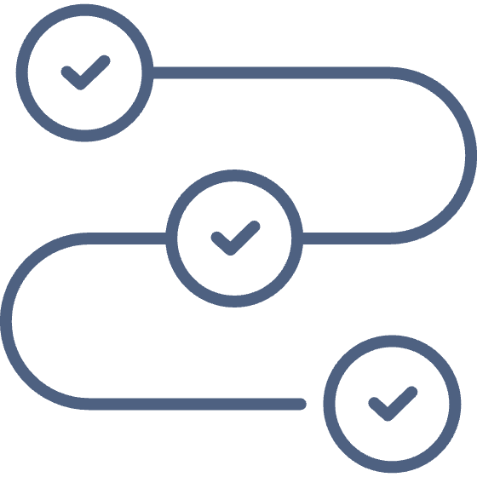
Navigating the EV Landscape:
Accelerating the Path to Electrification
INDUSTRY CHALLENGES
High capital investment to manufacture
Significant infrastructure investment needed
Large scale needed to reach profitability
Dependence on rare earth materials
EXRO DIFFERENTIATION
Our technology is the brain and the voice that controls an electric vehicle. We are changing the way the world consumes energy by delivering cost effective control solutions that improve system efficiency and total cost of ownership.
Asset light business model
Leading with technology that brings blue-chip validated solutions to OEMs
Path to profitability in 12 months

Slide 4

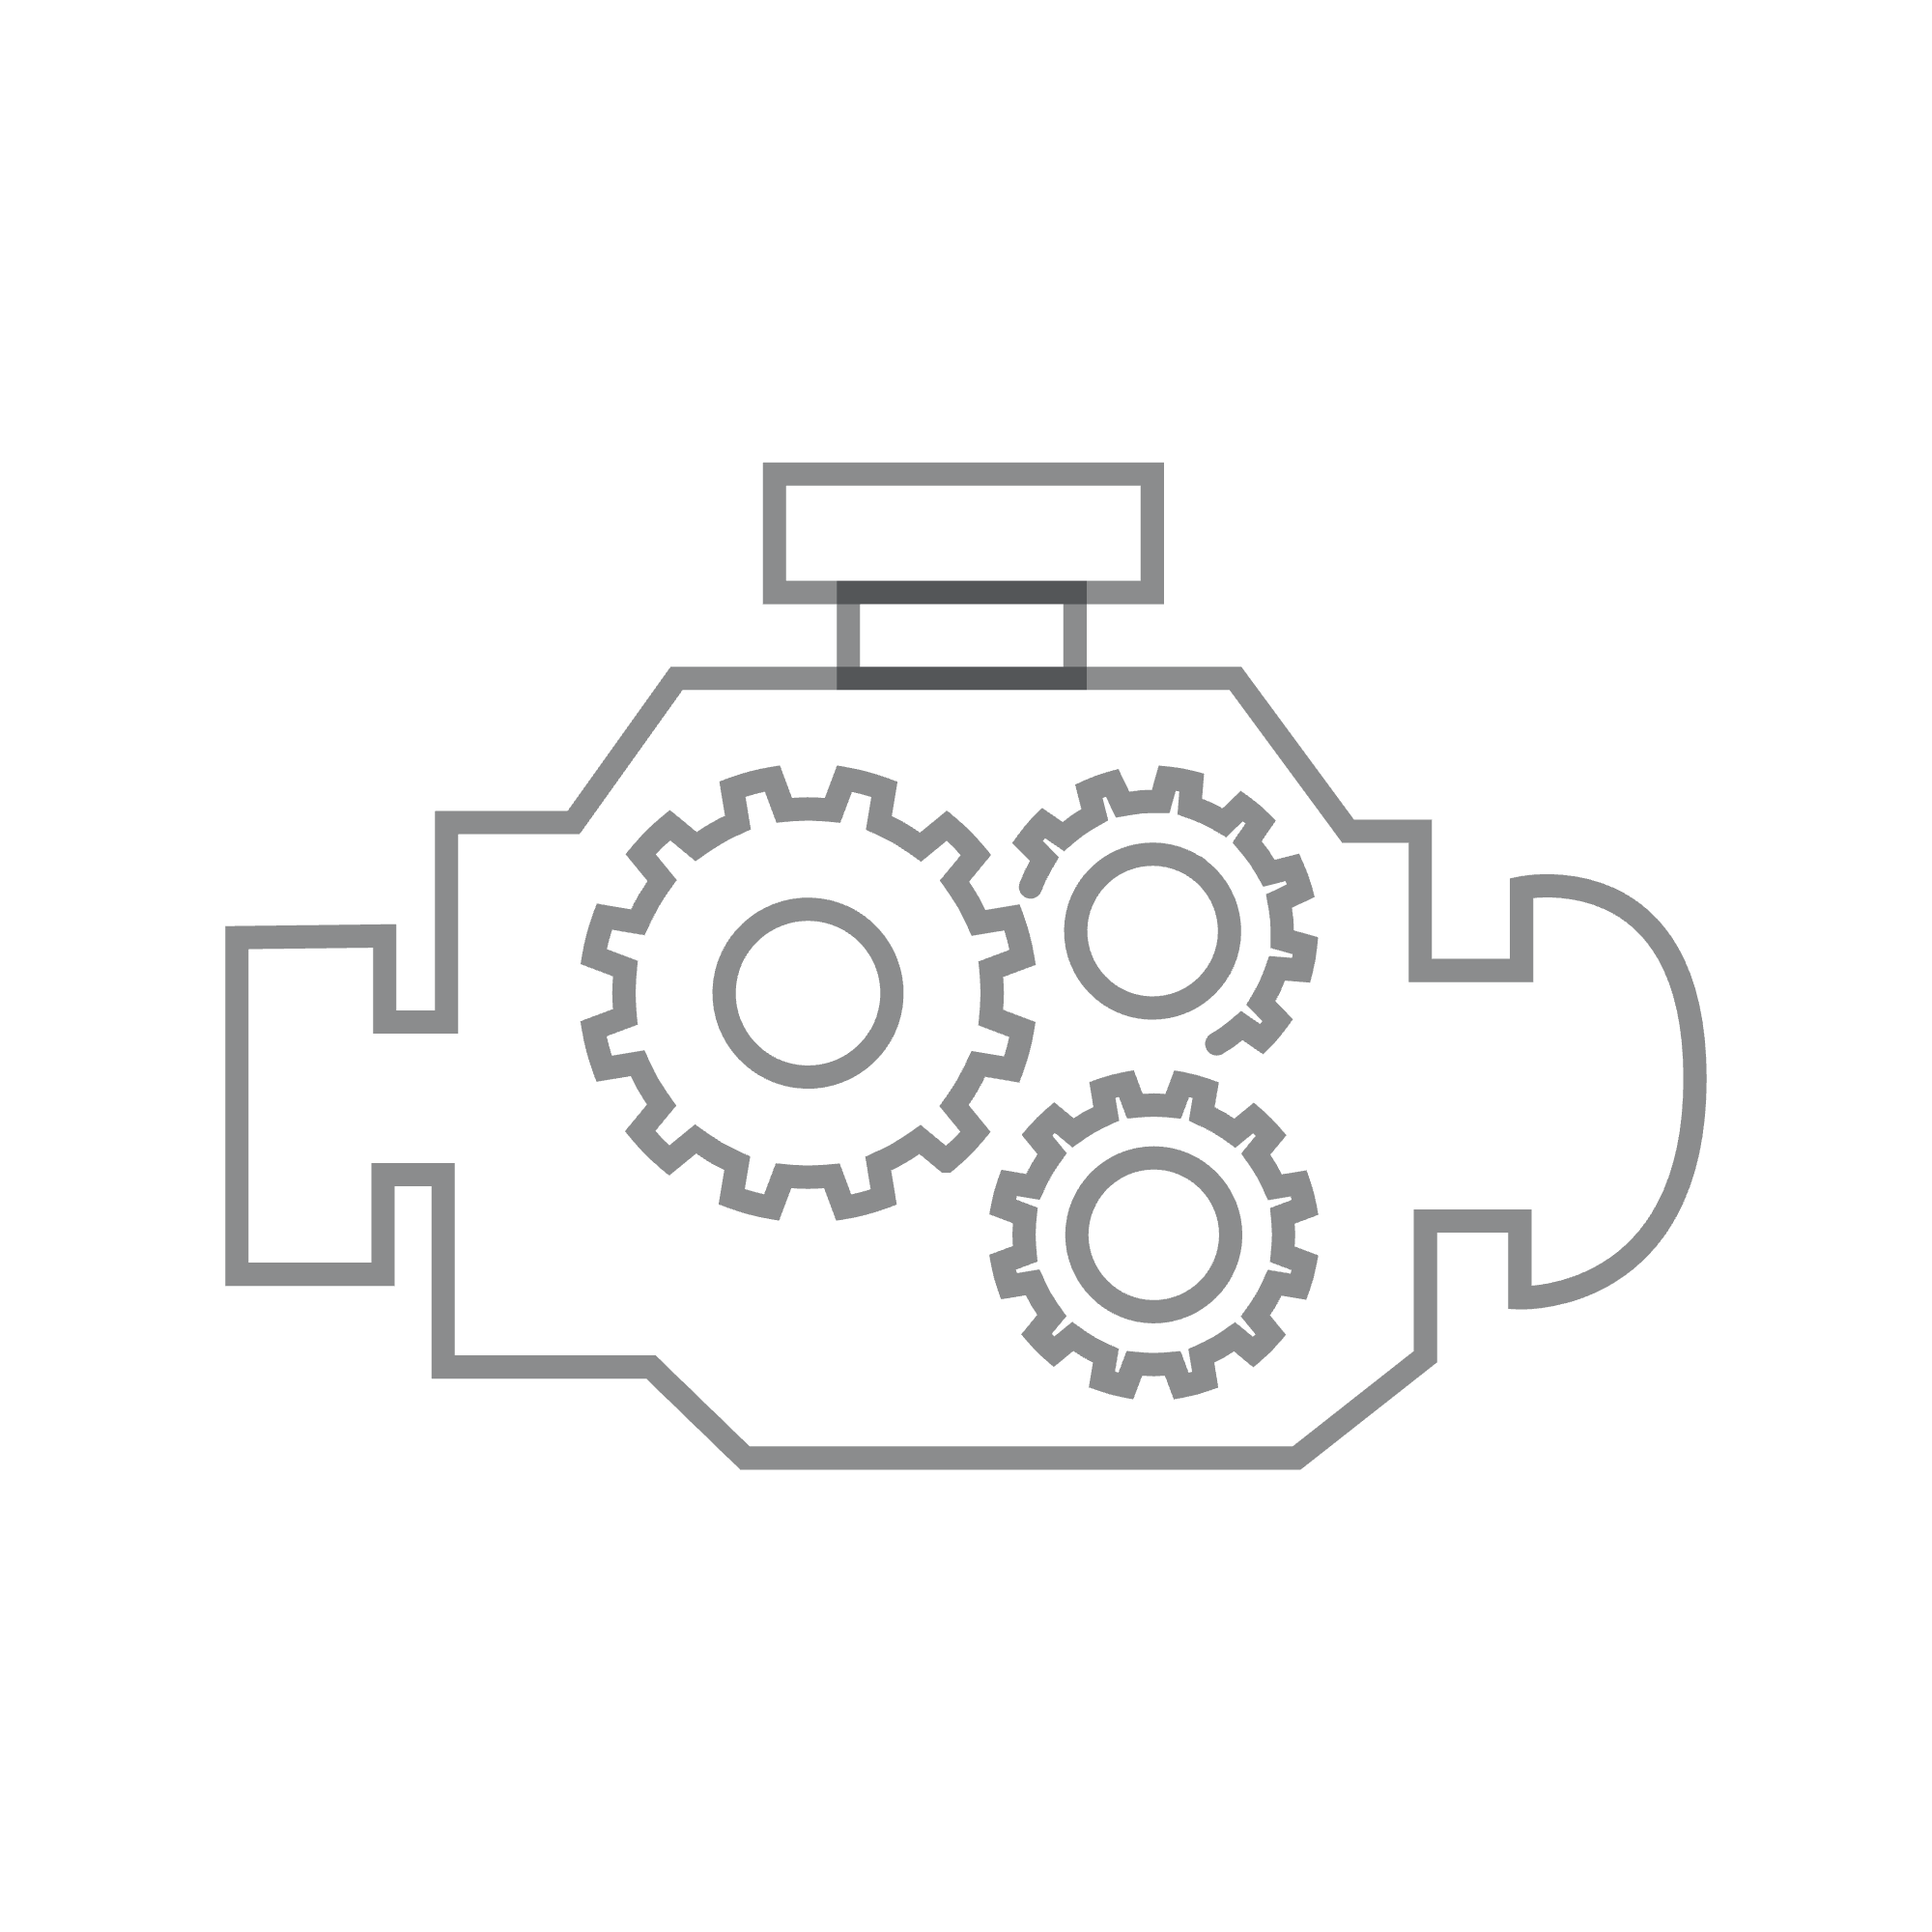


Why We Matter
TODAY
EXRO
ELECTRON GUZZLERS
PROVEN PROPULSION TECHNOLOGY
Inefficient real-world performance due to lack of harmony amongst various components.
3M+ miles of industry-leading efficiency, validated by blue chip OEMs.
COSTLY MECHANICAL FOCUSED SOLUTIONS
COIL DRIVER™ OPTIMIZES SYSTEM PERFORMANCE
Reliance on oversized and mechanical components that increase weight, complexity, and cost.
Electronically gear electric motors for improved performance, efficiency, and cost, while introducing next-generation AC fast charging.
LACK OF POWER ELECTRONICS EXPERTISE
A COMPUTER ON WHEELS
While OEMs excel in vehicle production, their limited power electronics know-how overlooks system-level savings and TCO advantages.
Patented software & hardware solution that right sizes electrification to reshape the way the world consumes energy.
Integrated Technology Platform Reduces Costs and Increases Efficiency in Electrifying Transportation

Slide 5
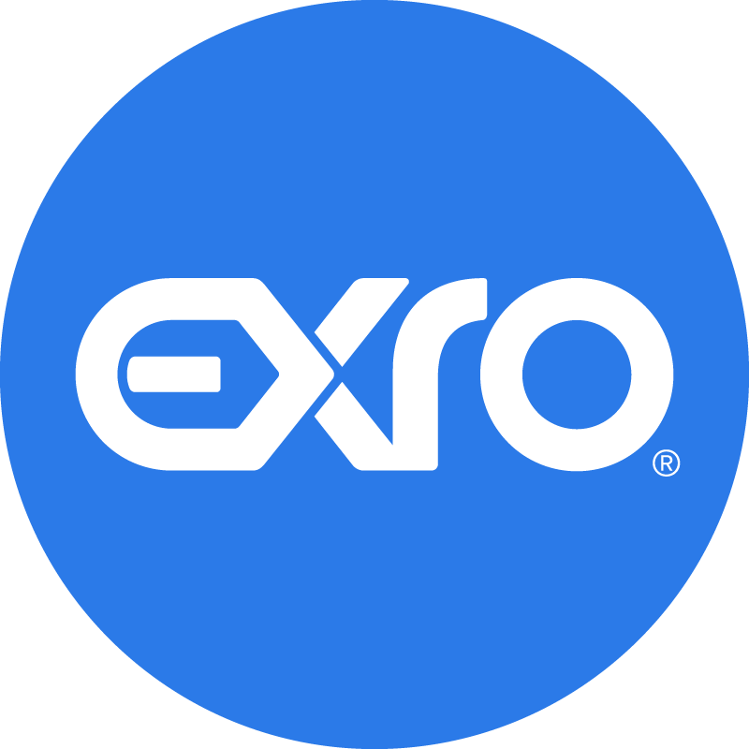
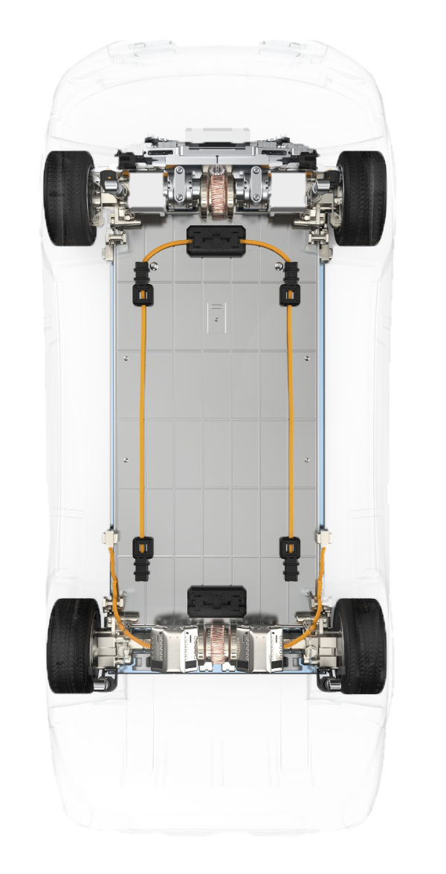
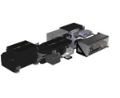
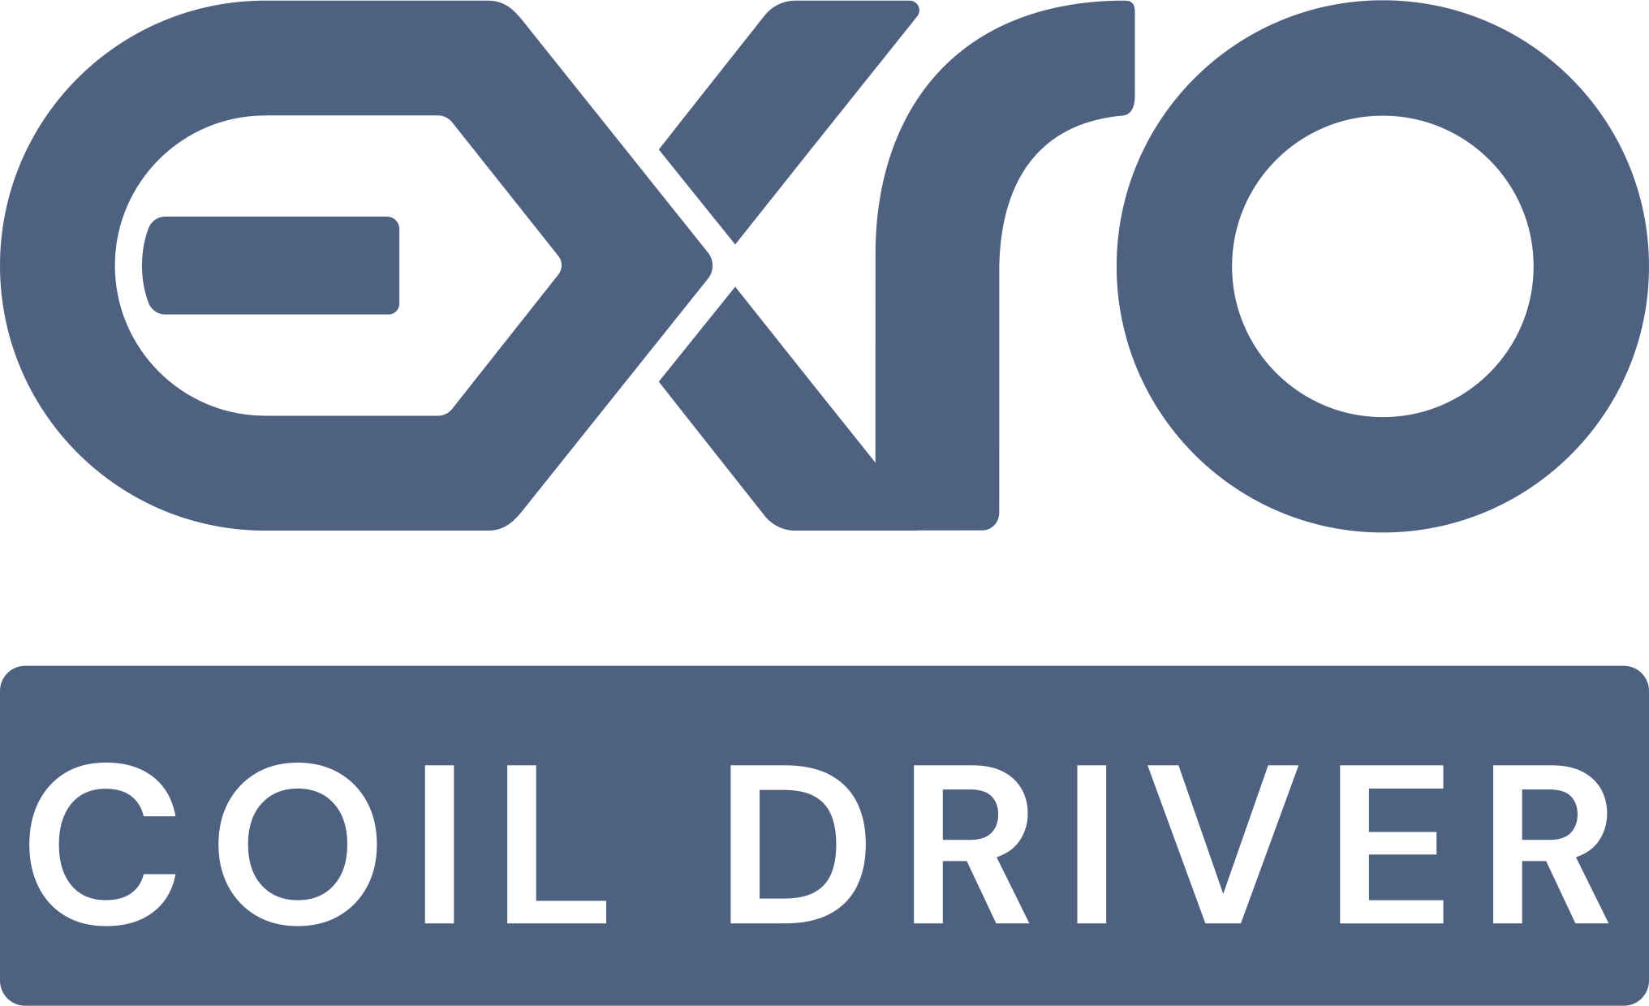
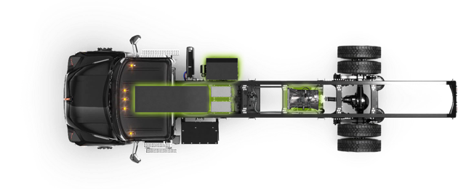


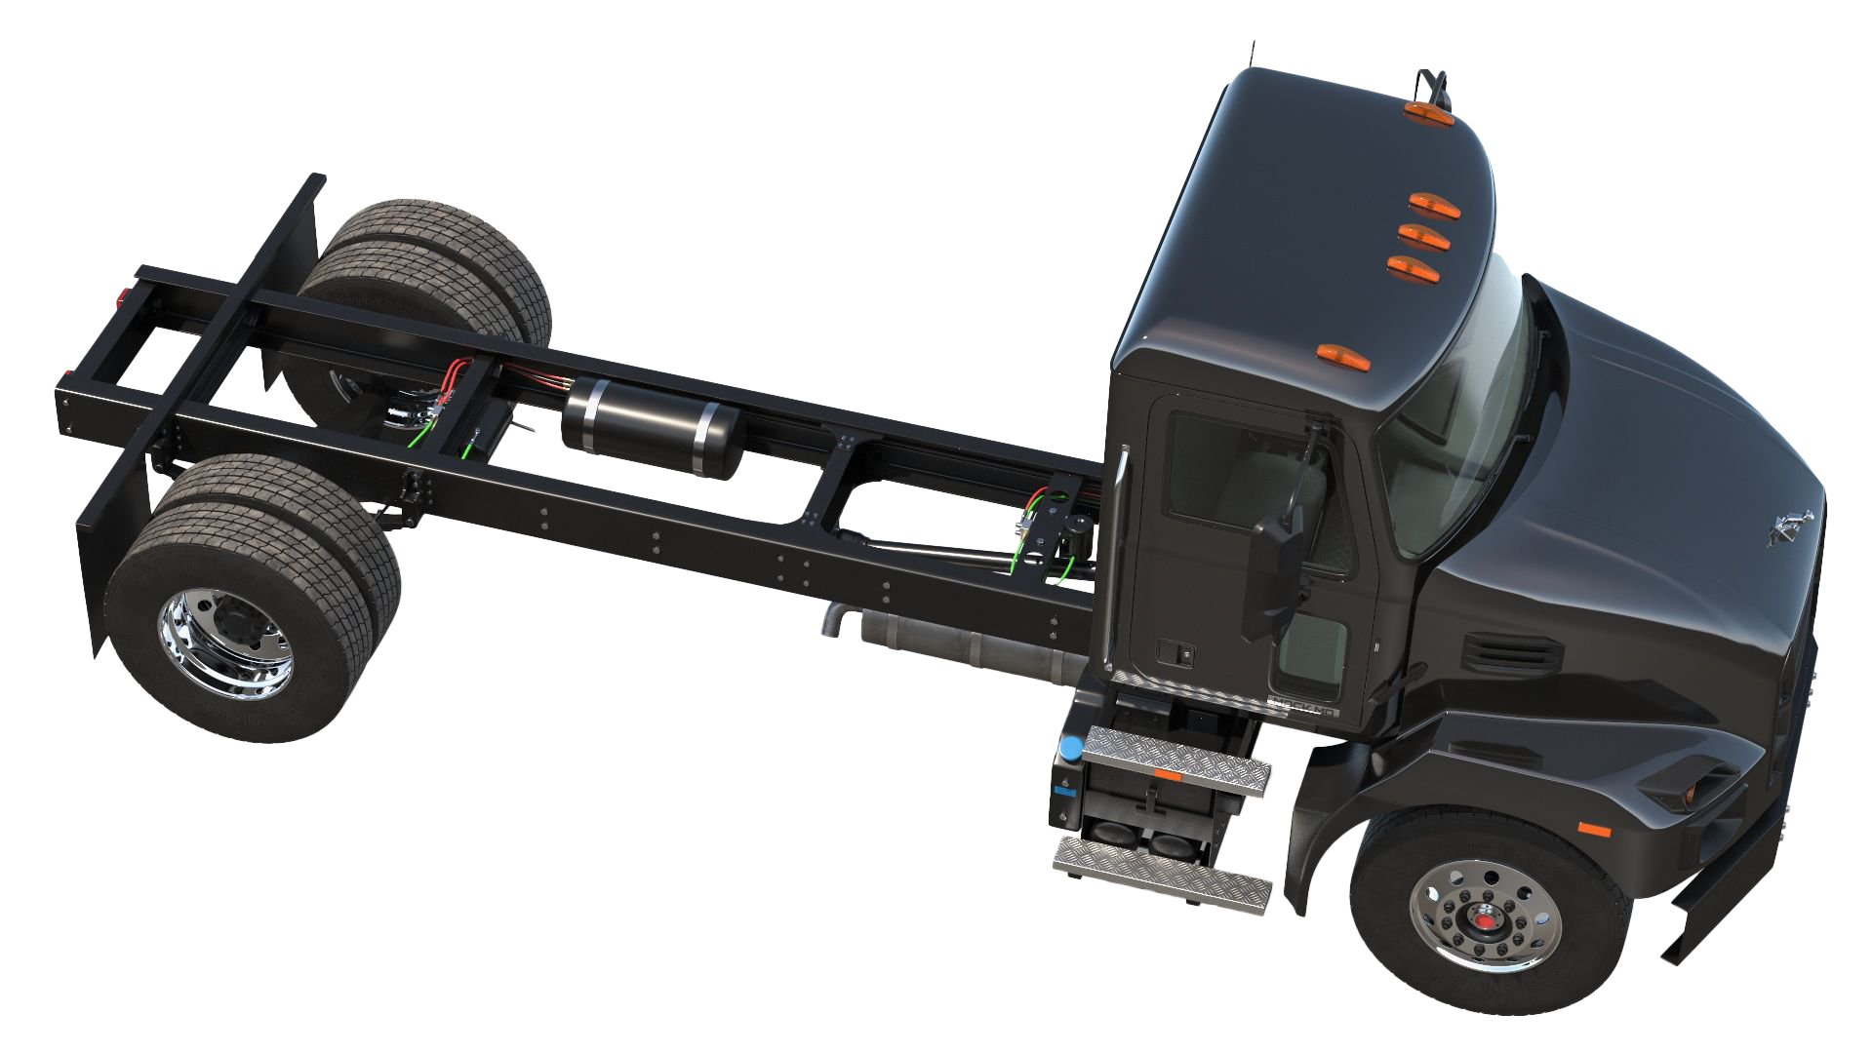
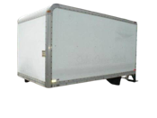
Exro Power System: Doing More with Less
More Range | More Torque | More Power | Less Cost
Standard Inverter
PASSENGER
COMMERCIAL
PROVIDED BY
1
Battery
2
Classic Inverter
3
Standard Motor(s)
2
3
4
PROPULSION SYSTEM
4
Standard Gearbox
AGNOSTIC TO APPLICATION TYPE
5
On-Board Charger
1
2
Wheel
2
SEA-DRIVE® VCU
1
BATTERY
Exro Inverter
1
1
Battery
3
COIL DRIVER™
MOTOR CONTROL
2
Exro Inverter
3
Optimized Motor(s)
MOTOR
PROVIDED BY OEM
PROVIDED BY BODY BUILDER
4
Reduced Reliance
3
5
On-Board Charger
Wheel

Slide 6

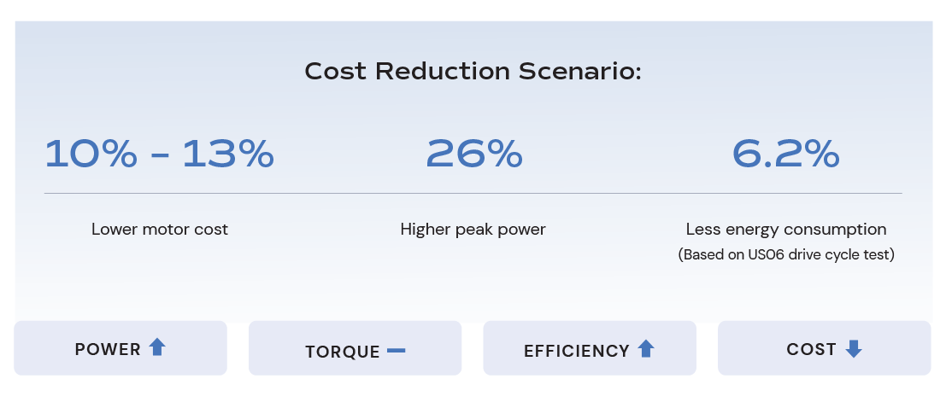
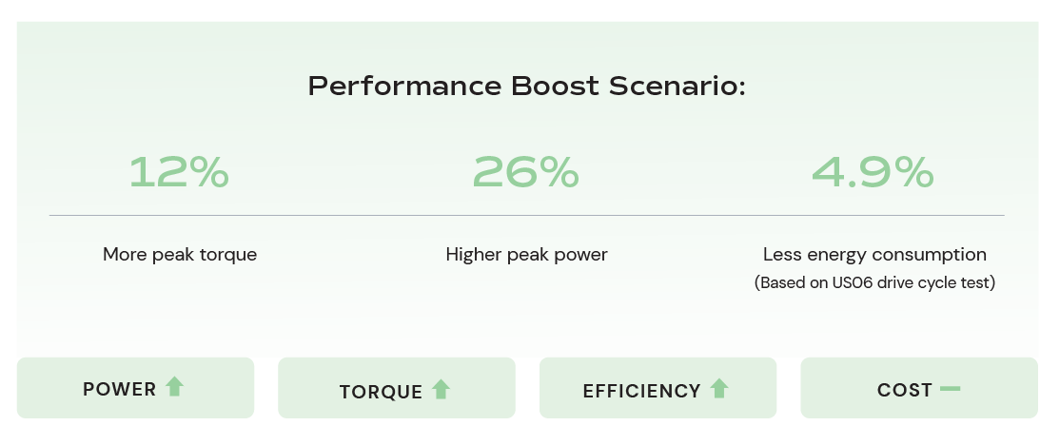
Delivering Cost Effective Commercial and Passenger Vehicle Solutions
Tech proven to beat the competition with over 3 million real-world miles driven
COMMERCIAL VEHICLES:
Ability to achieve on average >US$10,000 savings per vehicle. Based on the number of Volvo Trucks sold in 2022, that would equate to >US$50M.
Providing class-leading TCO, with the ability to further optimize the system via reducing battery size or introducing charging feature.
Real world driving conditions that offer unparalleled electric performance in a competitive package.
PASSENGER VEHICLES:
AVL Engineering’s simulation reveals Coil Driver™ significantly boosts performance and enables cost reduction.
Reduced battery pack size would save ~US$700/vehicle, equating for Tesla Model Y in 2022 to >US$500M.

Slide 7

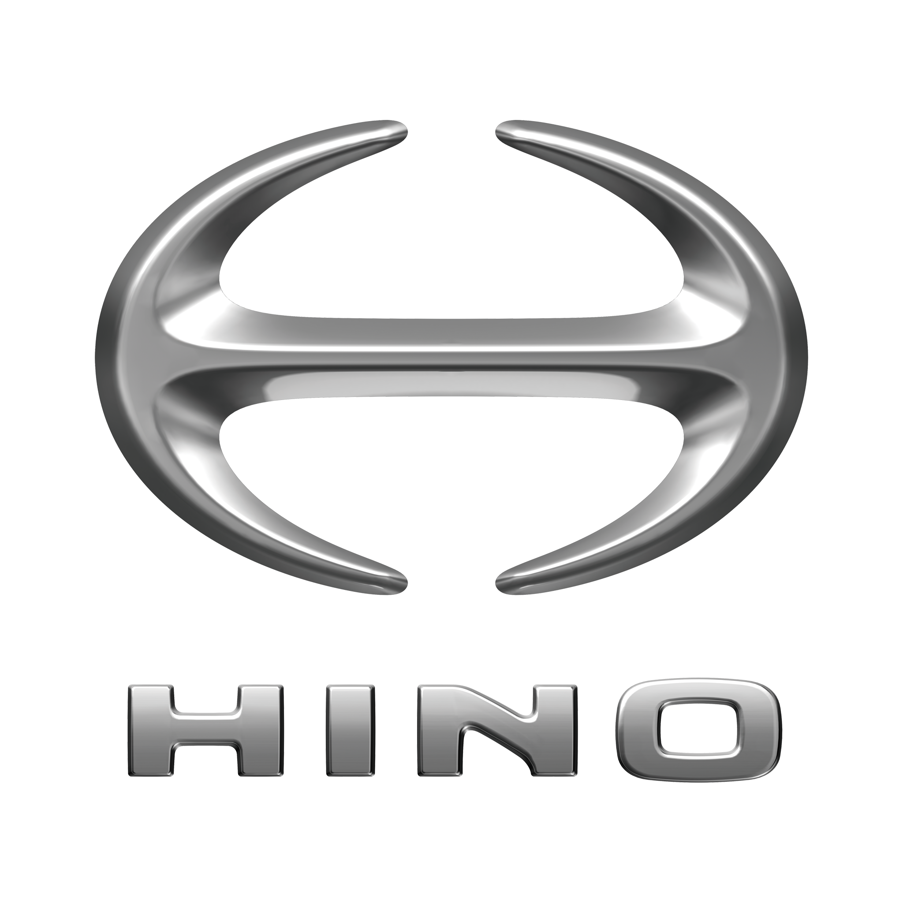

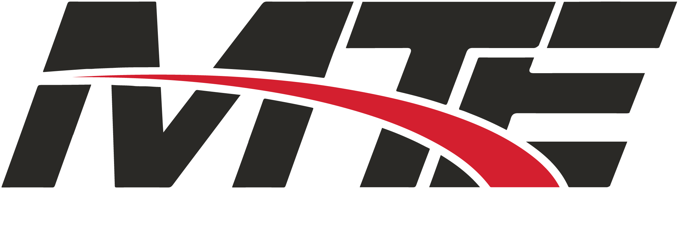


Established Distribution Network with Multi-Year Customer Contracts and 2024 Orders
OUR BLUE-CHIP CUSTOMERS’ DISTRIBUTION NETWORKS
Mack | 300+ Locations | 40+ Electric Certified
Hino | 200+ Locations
Small Fleets | MTE, UPS, APAC
PASSENGER / LIGHT-DUTY
MEDIUM-DUTY
HEAVY-DUTY
Induction Machines
Performance Vehicles
E-Propulsion Systems
E-Axle Systems
E-Propulsion Systems
Repower
NDA Global Top 5 OEM

Slide 8
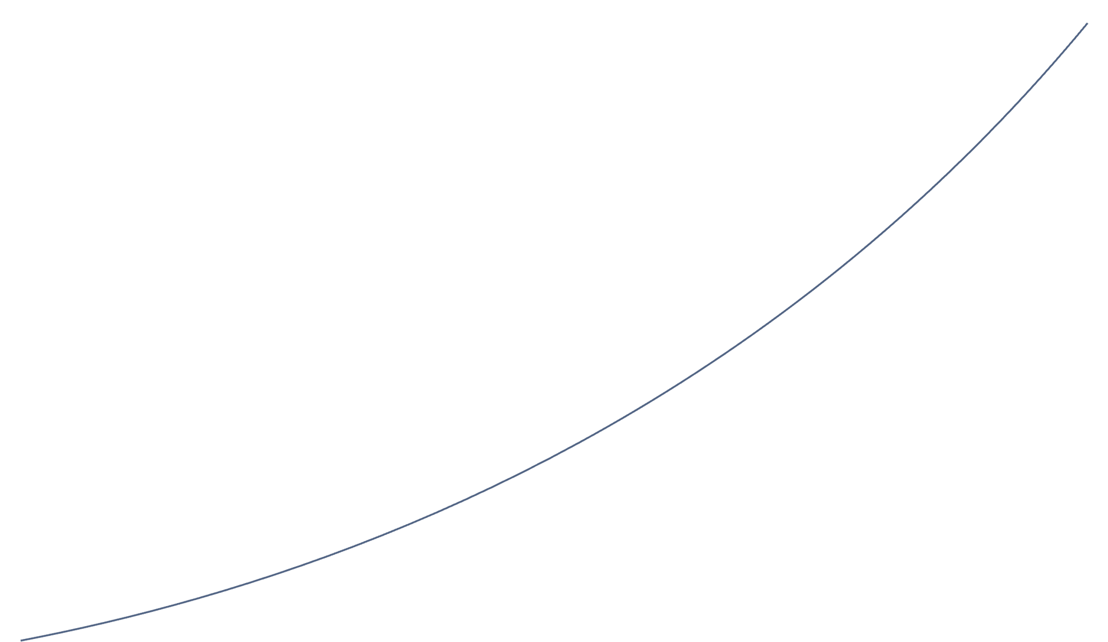

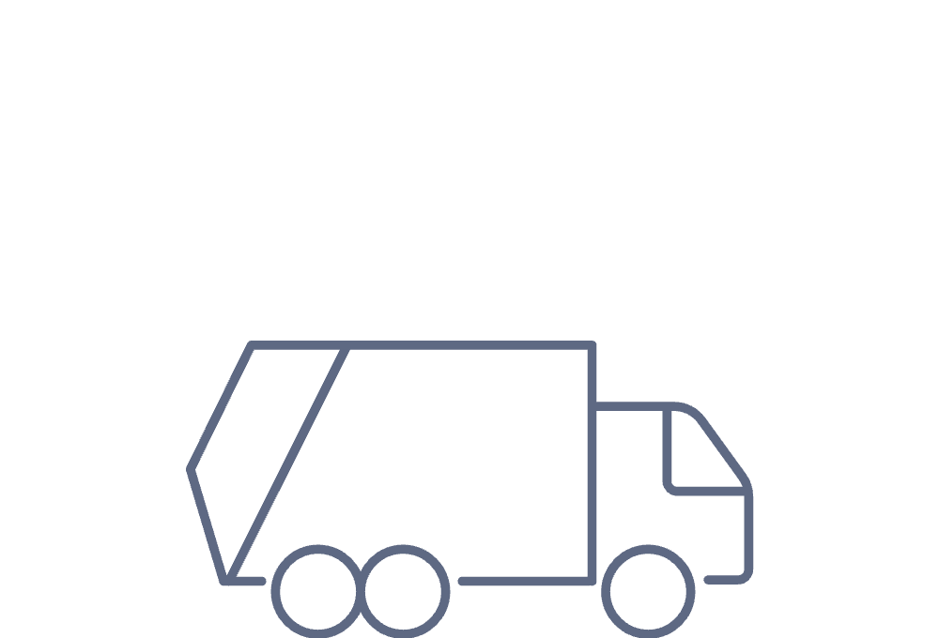
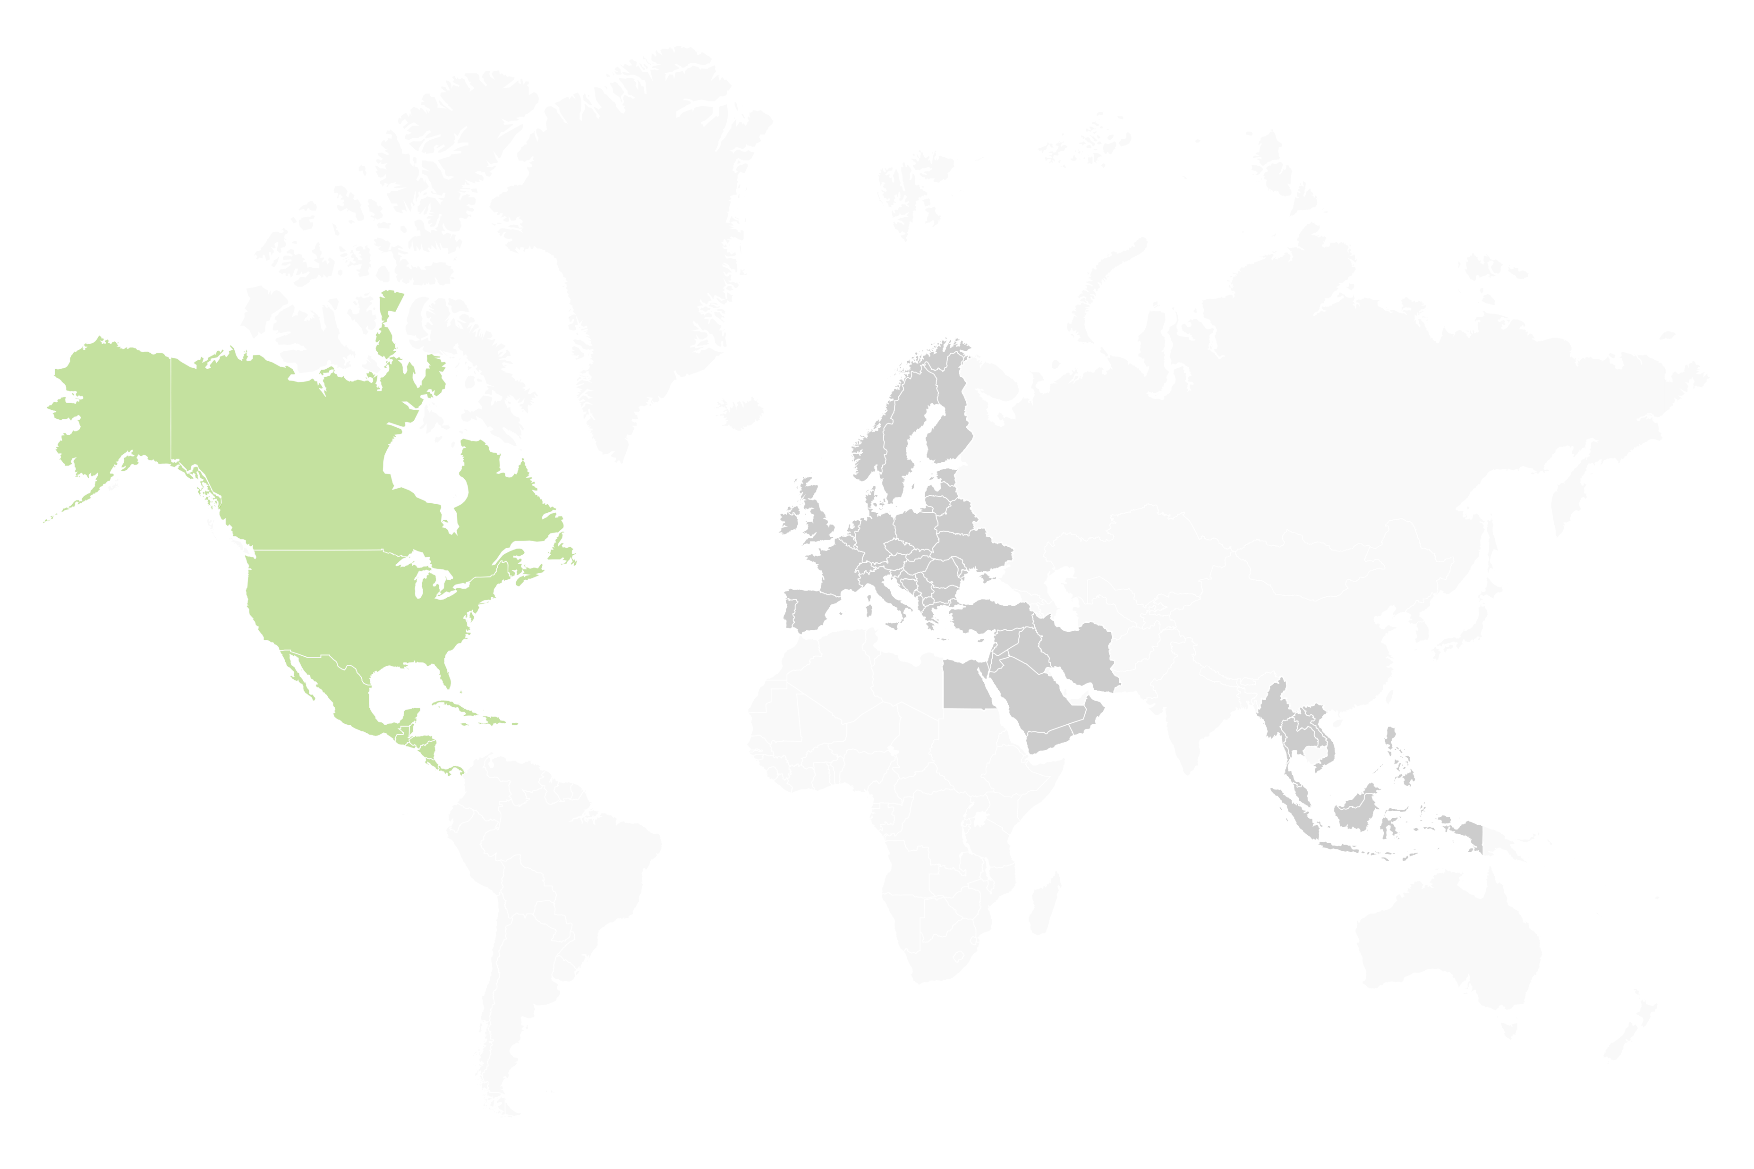
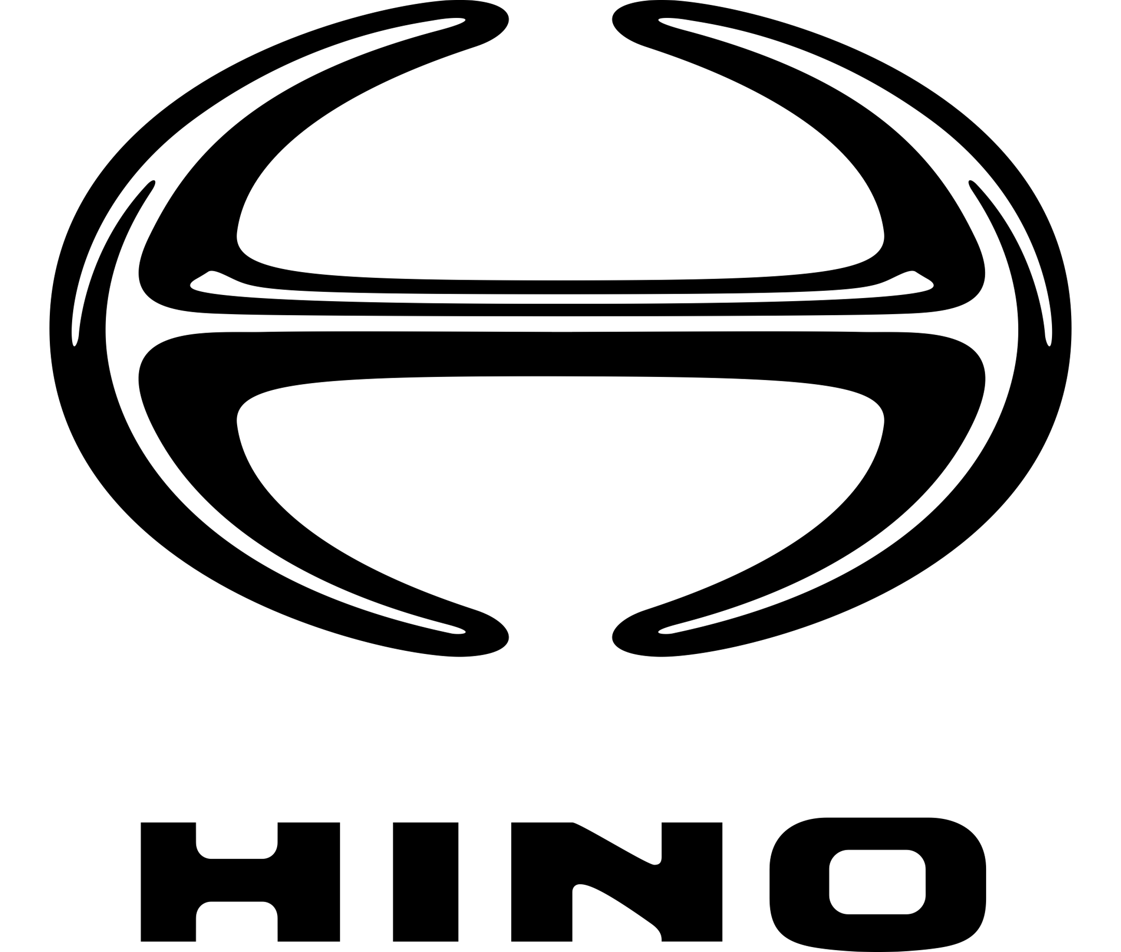








Focus on Execution
Multiple revenue streams to deliver short-term revenue and long-term growth
2026+
Long-Term Opportunities
2025
Adjacent Vehicle Classes
2024
Customer Expansion
Focus on Execution
Light Commercial
Class 8 Trucks
Hydrogen Ready Extended Range
North America
Europe
Middle East
SE Asia
Licensing Model - Patents
NDA Global Auto OEM
Win New Customers
Leverage Benefits of Fully Integrated Technology Platform to Drive Revenue Growth

Slide 9






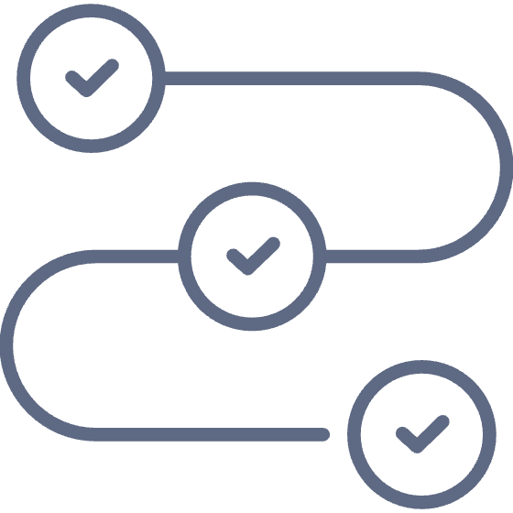
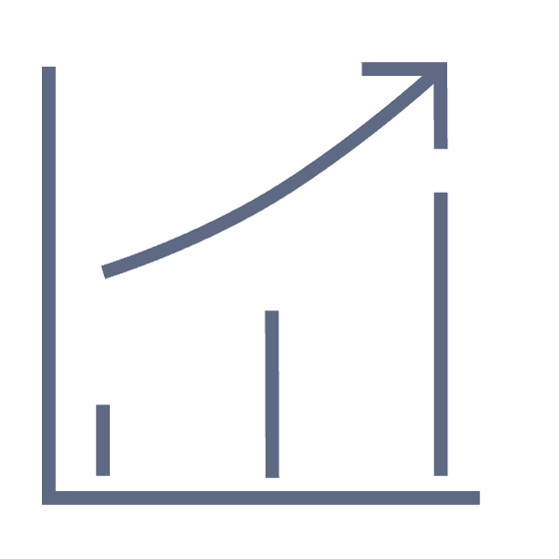
Goals – Innovation Realized Through Profitable Revenue
2024
Deliver on order book – 250 Systems in 1H Year
Cost synergies with 20% G&A reduction
First joint integration development
Supply chain efficiencies to drive 5% BoM reduction
New Innovation program
2025+
Path to profitability in 1H 2025
Additional customers
Expanded tech offerings (PV/CV/other) and geographies

Slide 10
Defined Path to Profitability
PROPULSION SYSTEMS
REVENUE
Systems
Q2: Ramp up to full capacity with 1 shift / 1 line per facility, Q3 add second shift, Q4 ramp to full capacity with 2 shifts / 2 lines
Revenue growth driven by ramp-up in volumes, fully supported by capacity at existing facilities
Expected supply chain efficiencies resulting in $7M synergies in 2024 and ~$20M in 2025
Team consolidation results in expected G&A
synergies of $13M+ in 2024 and ~$27M in 2025
GROSS MARGIN
EBITDA
Gross margin expansion driven by volume ramp-up and realization of supply chain synergies
Positive EBITDA achieved through ramp-up in volumes and realization of supply chain and G&A synergies
Note: All dollar amounts in CAD millions. USD figures converted to CAD at a USD/CAD FX rate of 1.3415.

Slide 11
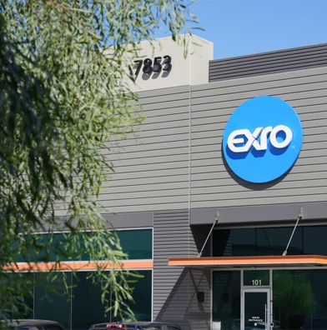
Capital Structure
Public company in US & Canada
Basic shares outstanding | 508.8 M
Options / RSU’s / PSU’s | 31.0 M
Warrants outstanding | 29.5 M
Fully-diluted shares outstanding | 569.3 M
Convertible Debt | $58.7 M
  Proforma Exro & SEA
  TSX: EXRO; OTCQB: EXROF
  NASDAQ ready
Capitalization and Q1 2024
*Exro Technologies has letter of acceptance to list on NASDAQ
For more information, read our press release “Exro Technologies Announces
Application to List on Nasdaq”.

Slide 12
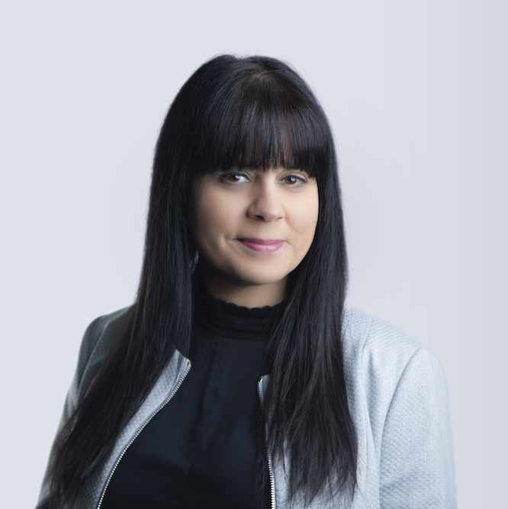
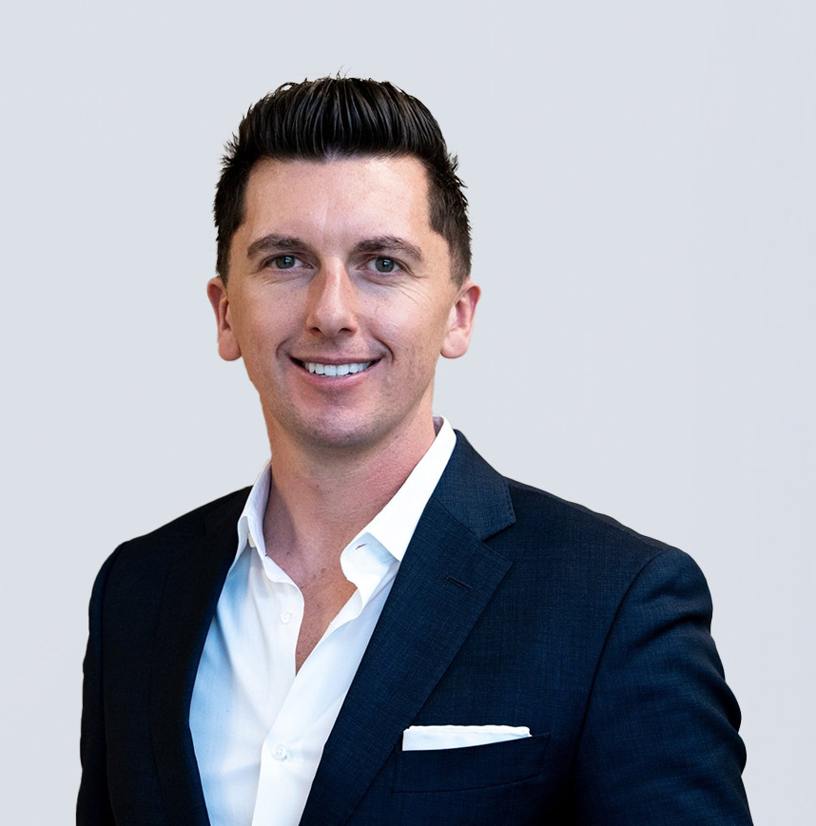
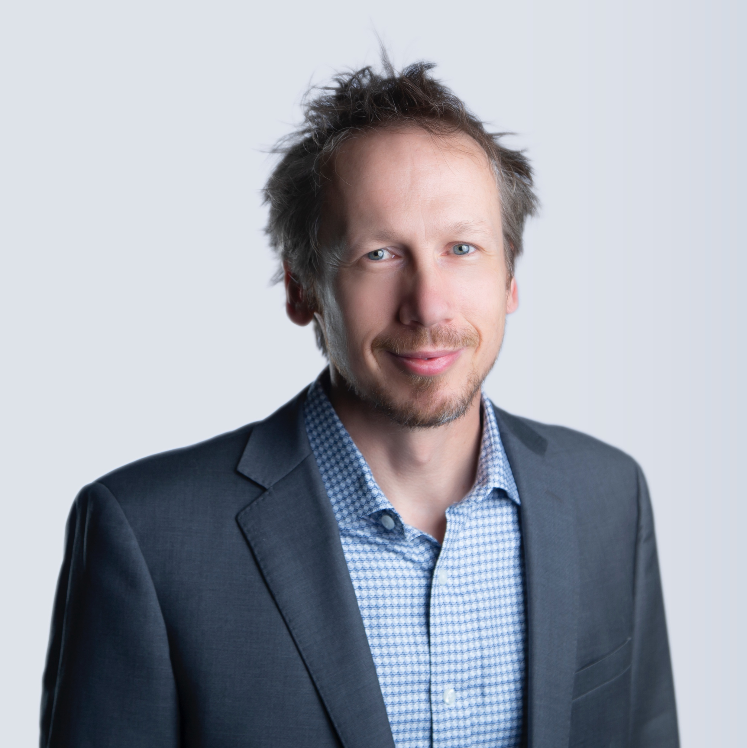
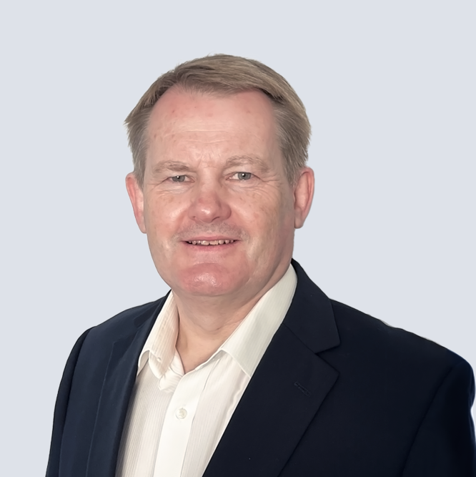
Management Team
Sue Ozdemir
Darrell Bishop
Chief Executive Officer
Chief Financial Officer
Former CEO of GE's Small Industrial Motors Division - General Electric (NYSE: GE) (“GE”).
$160M revenue enterprise
15 Years Experience in Investment Banking and Capital Markets
Peters & Co Limited, Haywood Securities, National Bank
Mechanical Engineer & MBA
Eric Hustedt
Simon Strawbridge
Chief Technology Officer
Chief Operating Officer
20+ Years Experience – Automotive Inverter Design and Manufacturing
International Rectifiers Automotive
KSR International, Vishay Intertechnology (NYSE: VSH)
20+ Years Experience – Automotive Inverter Design and Manufacturing
KSR Electronic Systems, Electronic Motion Systems

Slide 13
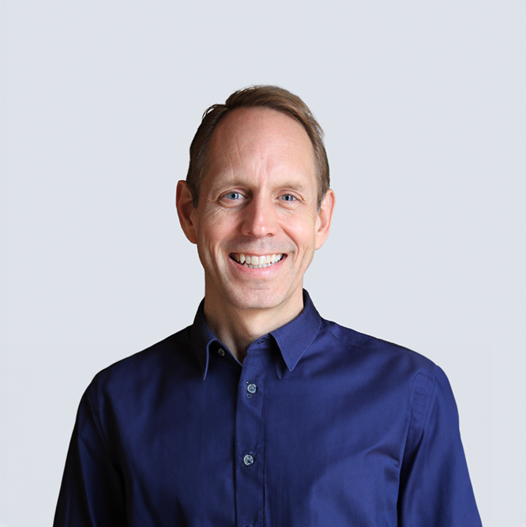
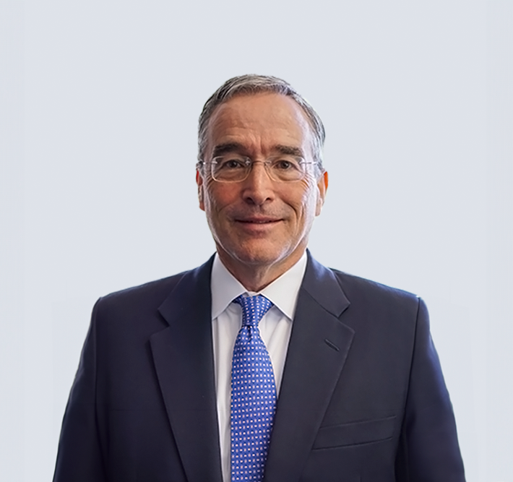
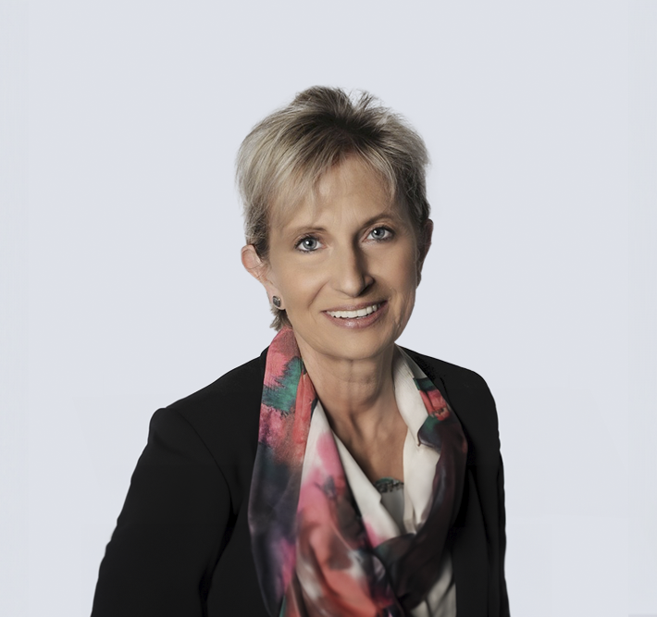
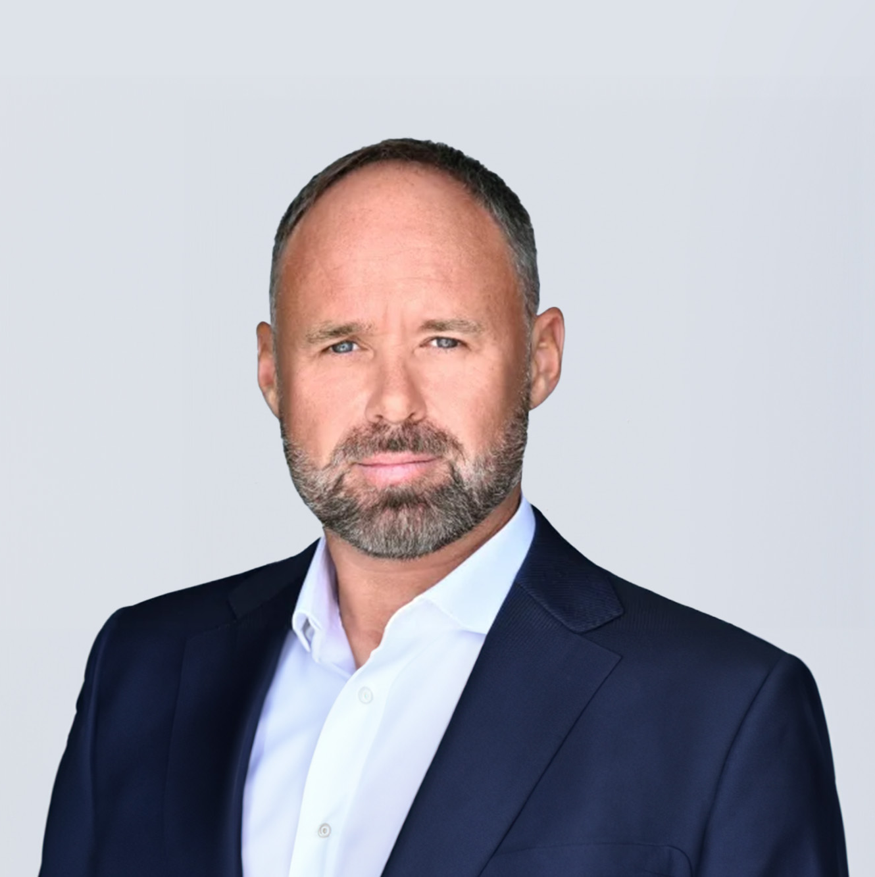
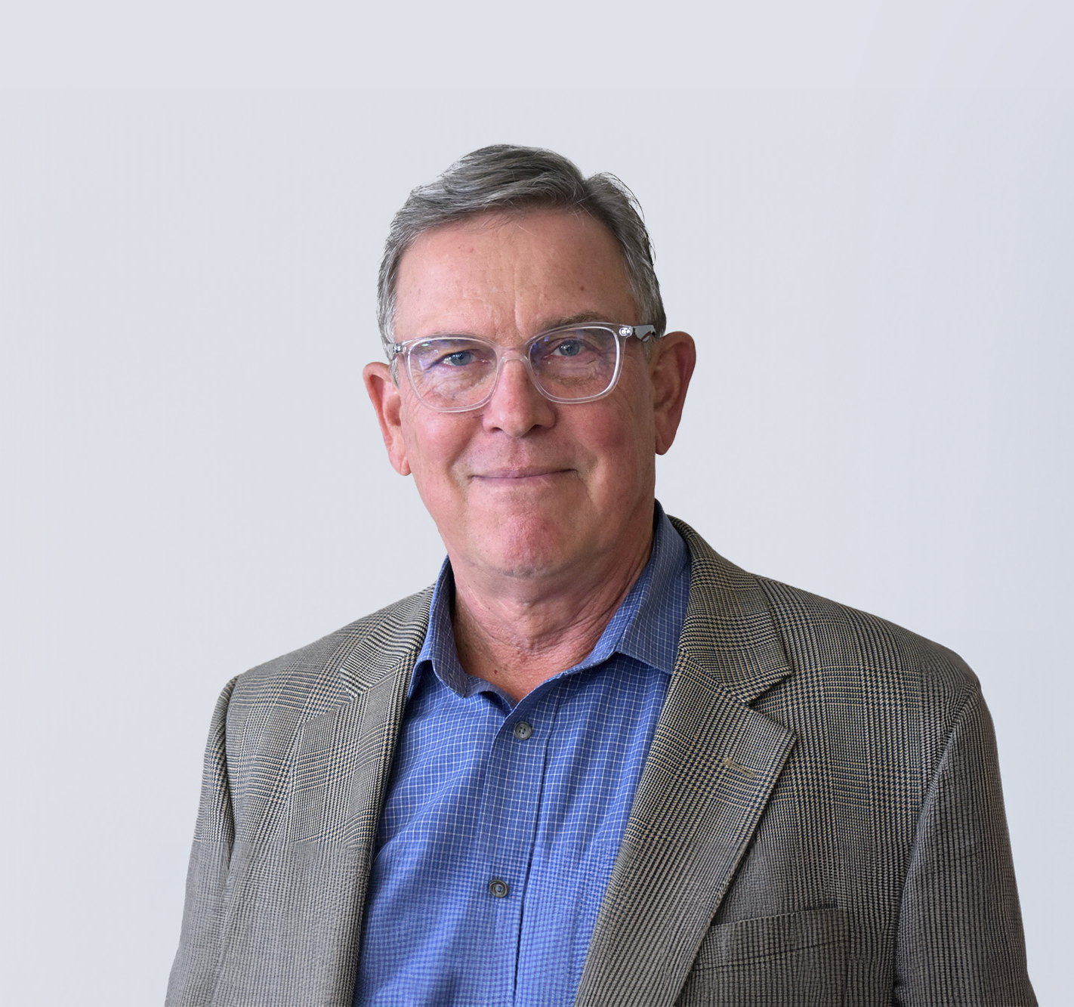
Board of Directors
Sue Ozdemir
Rod Copes
Chief Executive Officer
Chairman
Former CEO of GE's Small Industrial Motors Division - General Electric (NYSE: GE) (“GE”).
$160M revenue enterprise
Former Chief Operating Officer at Rivian Automotive; Former division President at Harley-Davidson
30+ years automotive executive
Frank Simpkins
Aleksandra Miziolek
Director
Director
Director, Power Solutions International, Inc. since 2017
Advisory Board member, Anovion Technologies, since 2022
Director American Axle & Manufacturing, since 2024; Director Solid Power Inc., since 2022
Former Director, Tenneco from 2020 to 2022
Former SVP, Chief Transformation Officer and General Counsel, Cooper-Standard Holdings Inc., from 2014 to 2019
Tony Fairweather
John MacLeod
Director
Director
Former CEO of SEA Electric
20+ Years Experience in transportation
TNT Express (now FedEx)
Former CEO of Rivet360, Executive VP at NAVTEQ, and senior finance and development roles at Sony and the Walt Disney company
Experience across technology, automotive, entertainment, and retail segment

Slide 14
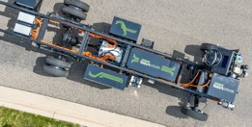
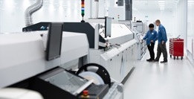
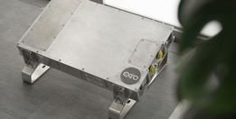
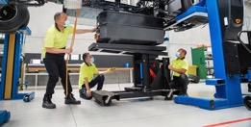
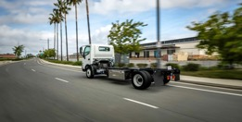
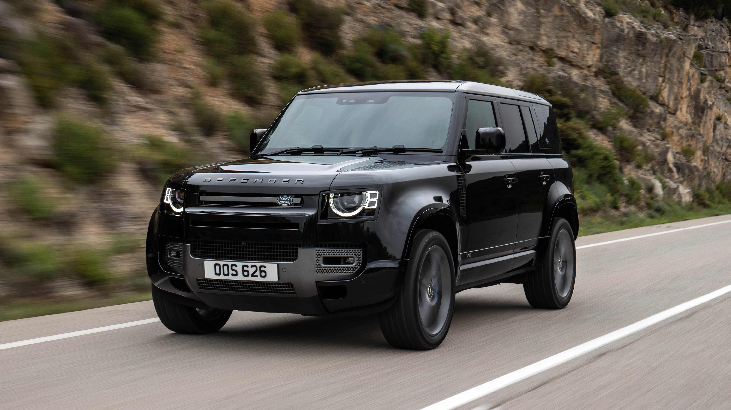
Investment Summary
Exro + SEA: Consolidation modernizes electrification with proven technology platform
Asset-light business model that disrupts the e-mobility space
Technology de-risked through extensive 3rd party testing, real-world miles, and ready to accelerate commercialization
Delivering revenue with blue-chip OEMs which provide unique leverage through ecosystem of distribution networks
Defined path to profitability backed by multi-year demand and strong backlog
Substantial upside from continued focus on innovation into e-transition market verticals

